Slide 1
Introduction to PHP Programming
Notes:
Type here……

Slide 2
Learning Objectives
-Write basic PHP scripts using variables and output
-Use conditional statements and loops to control program flow
-Create simple PHP functions to organize reusable code

Slide 3
What is PHP?
PHP PHP: Hypertext Preprocessor
A popular server-side (or back-end) Programming language
Used to create dynamic websites and web applications
Embedded inside HTML and runs on a web server (like XAMPP)

Slide 4
Why Learn PHP?
Powers popular platforms (WordPress, Facebook originally used PHP)
Simple and beginner-friendly
Works well with HTML and MySQL
Prepares you for building real-world systems

Slide 5
Setting Up Your PHP Environment
Download and install XAMPP
Save .php files inside htdocs/ folder
Start Apache to run your server or go to terminal php filename.extension

Slide 6
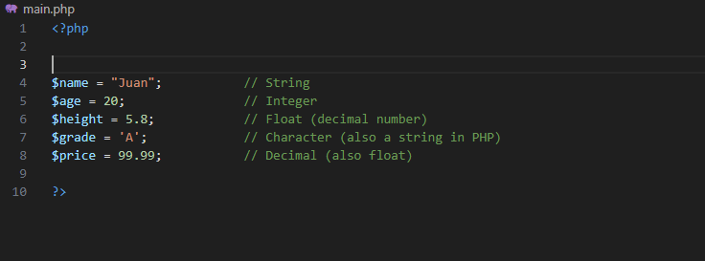
VARIABLES

Slide 7
Input and Output in PHP
Output is how PHP displays data to the screen.
We use:
echo → for simple output
Examples:
echo "Hello, World!";

Slide 8
Input and Output in PHP
Form Input (Web Browser)
-Uses $_POST or $_GET from an HTML form.
Command Line Input (Terminal)
-Uses fgets(STDIN) or readline()
-Used when running PHP from the terminal.
Notes:
php -m

Slide 9
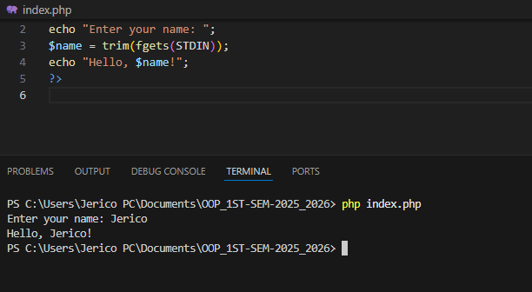
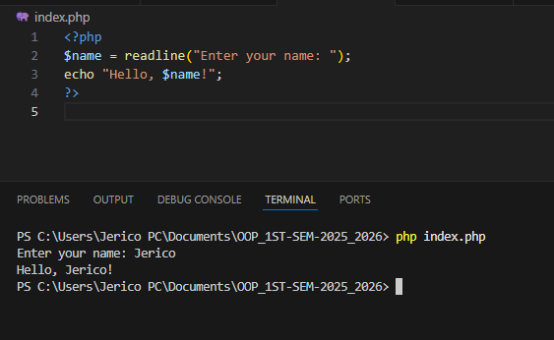
Input and Output in PHP
fgets(STDIN)
readline()
Notes:
Trim remove spaces

Slide 10
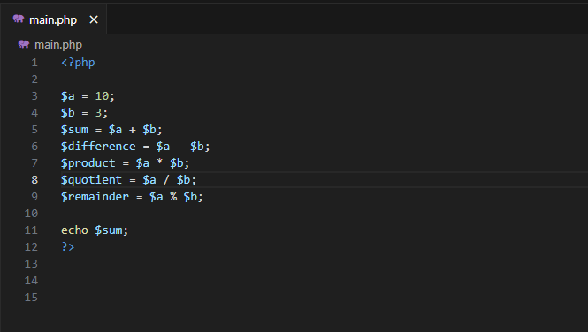
Operators
Arithmetic Operators

Slide 11
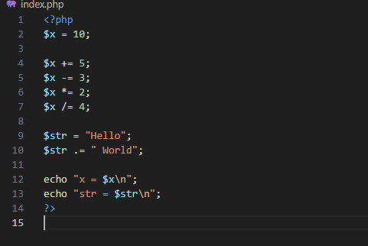
Operators
Assignment Operators

Slide 12
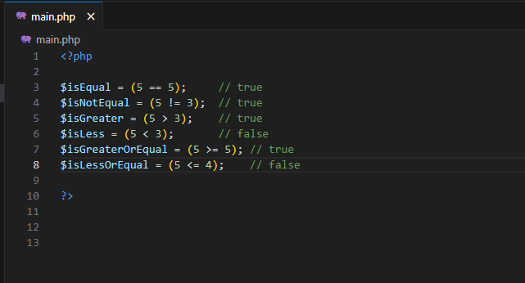
Operators
Comparison Operators
Notes:
(empty output means false in PHP, 1 means true)

Slide 13
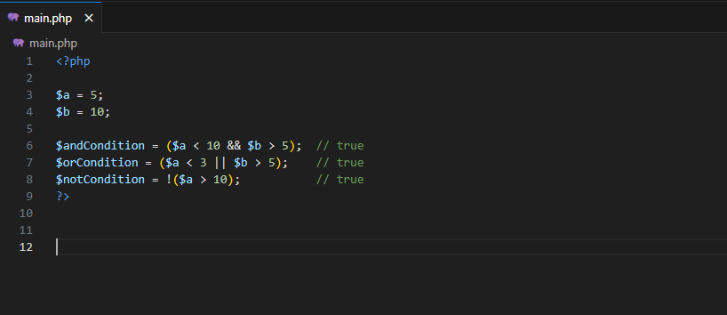
Operators
Logical Operators

Slide 14
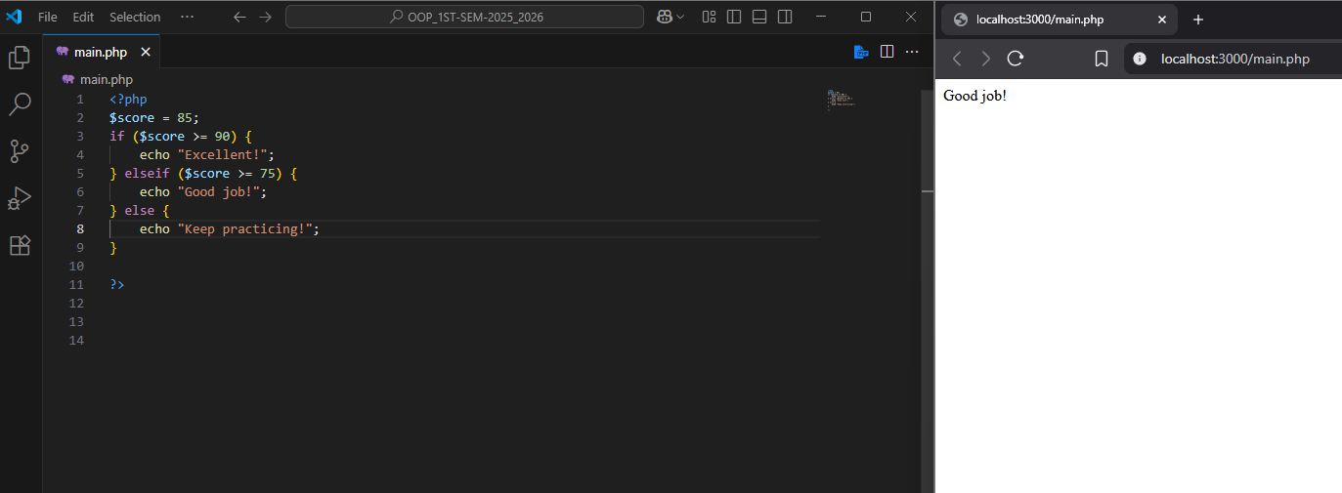
Conditional Statements

Slide 15
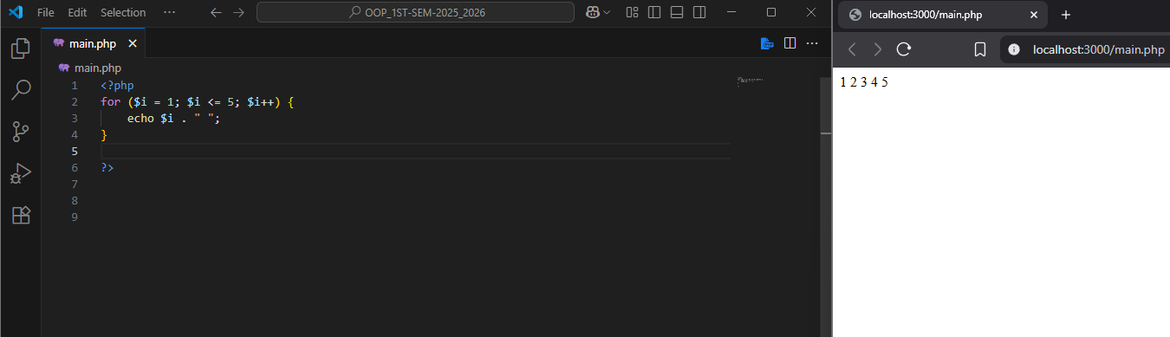
Loops – For Loop

Slide 16
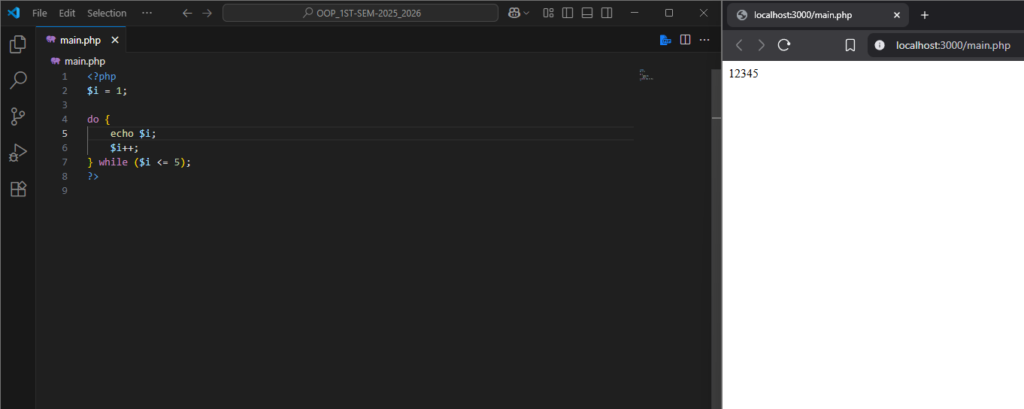
Loops – Do while

Slide 17
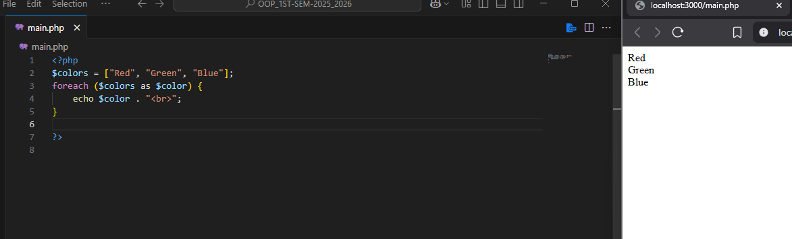
Loops – For Each

Slide 18
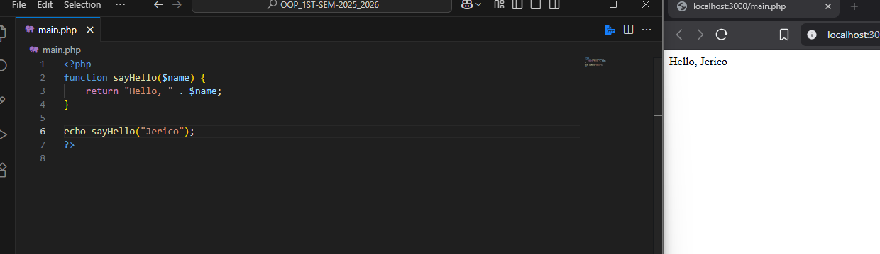
Functions in PHP

Slide 19
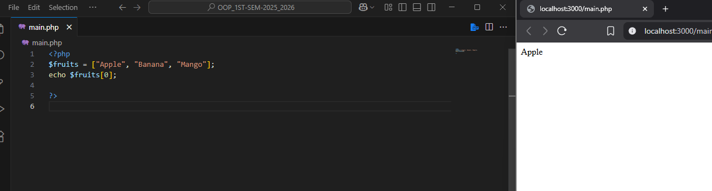
Arrays – Indexed Array

Slide 20
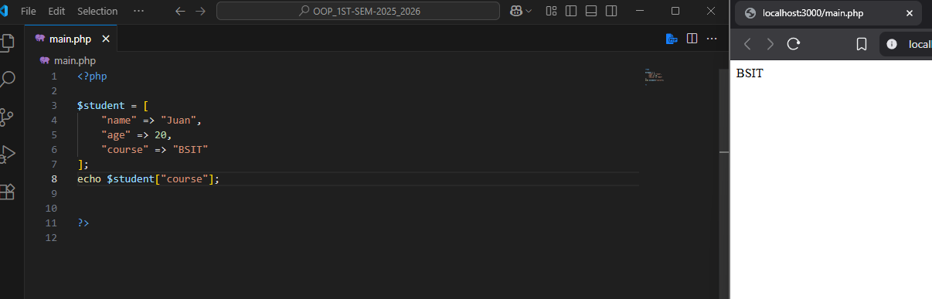
Arrays – Associative Array

Slide 21
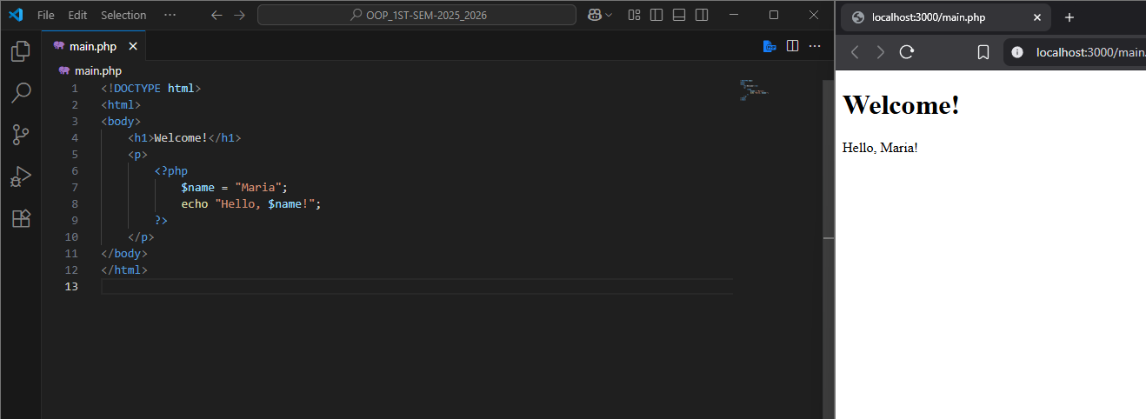
PHP Inside HTML

Slide 22
Practice Activity
Count Even Numbers Write a program using a while loop that asks the user to enter 7 numbers and counts how many of them are even.
1. Check if a Number is Positive or Negative
Write a program that asks the user for a number and displays whether it is positive or negative. (If it’s zero, display “Zero”)
2. Check if a Person is Eligible to Vote
Ask the user for their age. If they are 18 or older, display “You are eligible to vote.” Otherwise, display “You are not eligible to vote.”

Slide 23
Practice Activity
Count Even Numbers Write a program using a while loop that asks the user to enter 7 numbers and counts how many of them are even.
3. Largest of Two Numbers
Ask the user for two numbers and display which one is larger. If they are equal, display “Both numbers are equal.”
4. Grade Checker
Ask the user for a score (0–100).
90 and above → "A"
80–89 → "B"
70–79 → "C"
60–69 → "D"
Below 60 → "F"

Slide 24
Practice Activity
Count Even Numbers Write a program using a while loop that asks the user to enter 7 numbers and counts how many of them are even.
Print Even Numbers:
Use a for loop to print all even numbers from 1 to 20.
Count Even Numbers Write a program using a while loop that asks the user to enter 7 numbers and counts how many of them are even.

Slide 25
Thank you

